Slide 1
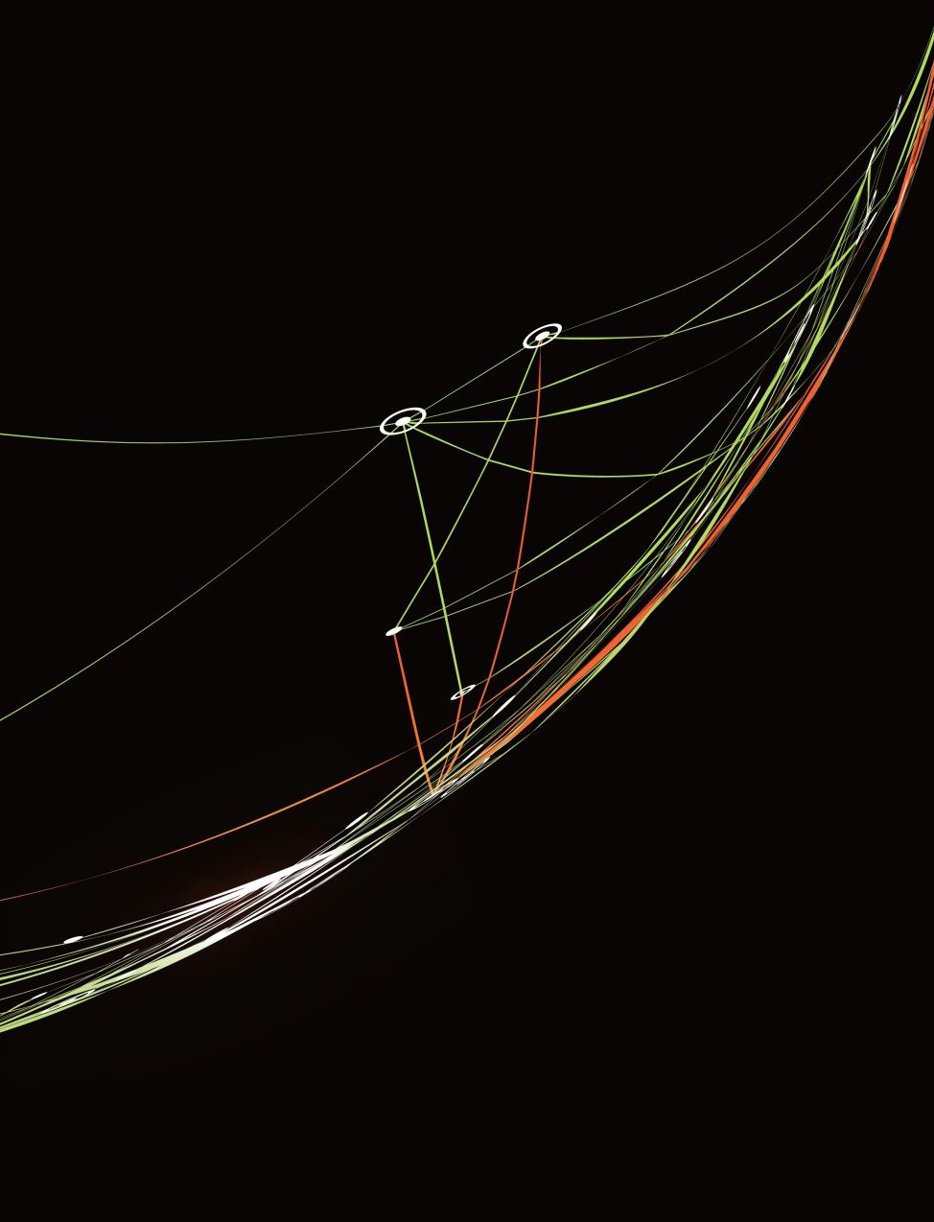
Intertextuality and Frankenstein
Allusion and relevant philosophical links

Slide 2
Human nature continuum
Humans are a blank slate
Human nature is innately good
Humans are innately violent
Hobbes
Locke
Rousseau

Slide 3
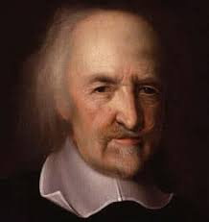
Hobbes
Thomas Hobbes (1588–1679) assumed that life in the state of nature would be intolerable. He argued that without police, courts, and other authorities to protect people’s lives and belongings from those who would take them, life would be “solitary, poor, nasty, brutish, and short.”
Hobbes believed this violence was a result of human nature: human beings are never content merely to satisfy their own needs because they have “a perpetual and restless desire of power after power, that ceaseth only in death.” The desire for domination over others inevitably leads to conflict. Hobbes argued that government was justified because only it could prevent the violence endemic to the state of nature.

Slide 4
Hobbes on Good and Evil
“But whatsoever is the object of any man's appetite or desire, that is it which he for his part calleth good, and the object of his hate and aversion, evil; and of his contempt, vile and inconsiderable. For these words of good, evil, and contemptible are ever used with relation to the person that useth them: there being nothing simply and absolutely so; nor any common rule of good and evil to be taken from the nature of the objects themselves; but from the person of the man, where there is no commonwealth; ... ”
People may generally value such abilities as wit, discretion, and prudence; but they do not thereby establish any absolute goods. Even a universal inclination of human beings is not an absolute good, although it describes human nature. Such an inclination is power. He says,
“So that in the first place, I put for a general inclination of all mankind, a perpetual and restless desire of power after power, that ceaseth only in death. And the cause of this, is not always that a man hopes for a more intensive delight, than he has already attained to; or that he cannot be content with a moderate power: but because he cannot assure the power and means to live well, which he hath present, without the acquisition of more.”

Slide 5
In summary
Hobbes believed we are born with an innate capacity for violence. We are brutish, and society works to contain our violent nature and turn us into civilised beings.
Discussion – do you agree with Hobbes? Why or why not?
What implications does this perspective have for concepts like altruism, empathy and love?

Slide 6
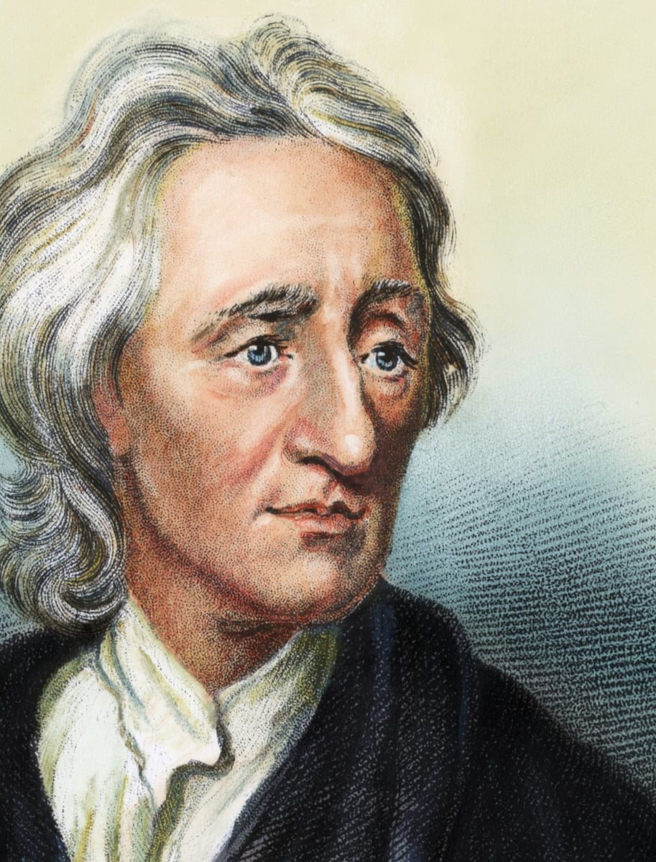
John Locke – 1632-1704 Tabula rasa – blank paper
Locke believes we are born as a blank slate – the experiences in our life inform who we become.
This means that people aren’t born with innate ideas. Infants must learn from an educator and as the person grows up he/she will fill that empty brain with knowledge. He stresses on the fact that experience is everything in terms of education.
Locke’s theory of “tabula rasa” inspires Shelley’s development of Frankenstein’s creature. A creature that is empty-minded must educate itself through experiences it encounters throughout its aimless journey through an unknown place. Ultimately the creature develops feelings such as empathy and regret as we saw when the creature met the poor family, and when the creature committed murder.

Slide 7
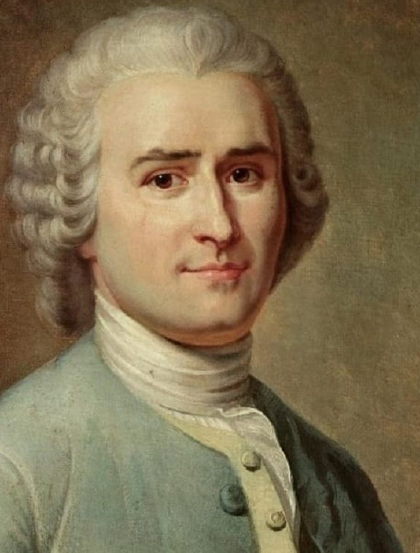
Rousseau 1712-1778
Jean-Jacques Rousseau’s picture of the state of nature, and human nature, was the opposite. He argued that people in their natural state were motivated by what he called amour de soi: a “love of self.” This meant living primarily to eat, sleep and reproduce for the continuation of the species. People with such minimal desires could meet their needs without resorting to violence and so life was peaceful, not the war “of every man, against every man” that Hobbes theorized.

Slide 8

The drive for competition
Amour de soi – love of the self
Amour propre – love of competition. It is inherently competitive, focused on standing out and being noticed among the crowd. And, crucially, it is a value that must be had at another’s expense: we cannot all be the best.
Discussion: What are some modern examples of this?
How does this relate to our reading of Frankenstein?

Slide 9
In summary
Rousseau believes our nature to be peaceful as long as our basic needs are met. This means we are born without a violent capacity, and can be contented with life.
Discussion: what are your thoughts on Rousseau’s perspective on human nature?
What implication does this have for our reading of Frankenstein?

Slide 10
Rousseau and Frankenstein
Rousseau says unlike Locke that humans are blank slates but rather that they come into the world with compassion and self-preservation, and the rest of their education needs to be learned through man, nature and things (experiences). Therefore he believes that humans by nature have the potential to do well and be good. The only thing that hinders people from innocence is the influence others have that can corrupt them.
Here we see the role of an educator as an extremely important aspect of ones education. We can now go back and take a look at Frankenstein’s creature. It had been rejected and abandoned by its creator, the one who is supposed to love you the most and show the most compassion and guidance. The creature is described as a “noble savage” at first and is then later labelled as a malevolent monster. The creature had no educator to guide its development and structure its manners toward itself and others.

Slide 11
State of Nature
Hobbes | Locke | Rousseau
“... in the nature of man, we find three principal causes of quarrel. First, competition; second, diffidence; thirdly, glory…The first, maketh men invade for gain; the second, for safety; and the third, for reputation.” In offering this description, Hobbes does not assert that human nature is evil because, in the state of nature, there is no morality. Ethical notions such as the inviolability of the person, property rights, and justice are simply non-existent as guides to action. Without some common power to enforce these notions, only fools would respect them. Key word: self-interest. | John Locke believes we are born as a blank piece of paper (tabula rasa) and absorb the lessons taught to us by our educators. Tabula rasa is the theory that individuals are born without built-in mental content, and therefore all knowledge comes from experience or perception. Locke holds that the mind is a tabula rasa or blank sheet until experience in the form of sensation and reflection provide the basic materials—simple ideas—out of which most of our more complex knowledge is constructed | "There is, then, deep in our souls an inborn principle of justice and virtue by which, in spite of our maxims, we judge our actions and those of others as good or bad; and it is to this principle that I give the name of conscience.” We are born with a drive for self-preservation and for compassion. Our natural state is one of minimal desires (food, rest, safety) and a rejection of evil. We are actually corrupted by society. We are born with a capacity for good.

Slide 12

Reflection
Now that you have explored three philosophical perspectives on human nature, which one do you most closely align yourself with?
Be prepared to stand up and vote. You must be able to justify your vote.

Slide 13
Frankenstein and philosophy
Which perspective aligns most closely with Frankenstein’s depiction of mankind? You can consider multiple perspectives, and different sections of the novel may align with differing ideas about human nature.

Slide 14
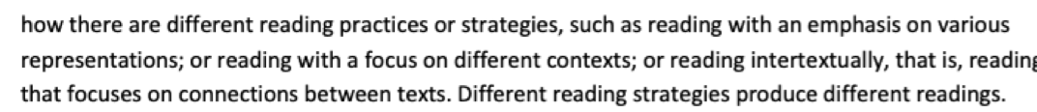
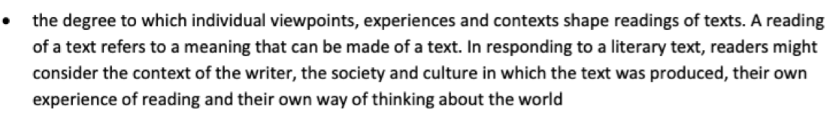
Syllabus link and potential essay questions
This study of intertextuality relates to the syllabus dot points:

Slide 15
Bringing textual evidence together with intertextual links
The creature’s innocence in Chapter 5 discussed in relation to Locke or Rousseau’s theory of human nature – how we might interpret his actions versus how Frankenstein interprets them.
The creature’s drive to learn – learning from Milton, for example, to form his view of himself and Frankenstein. Who is Adam and who is the devil?
Victor Frankenstein, playing God, resembles Satan from Milton's Paradise Lost, in which Satan is an archangel punished for his vanity, arrogance, and thirst for forbidden knowledge. Like him, Victor attempts to take over God's role as creator and master of the universe.
Considering the ethical choices made by the creature from the perspective of Locke or Rousseau – can he be blamed based on who his teachers were? How was he corrupted by society?

